Slide 1
COVID CARE
By Team Coden’t
Team members :
Yaswanthi .O
Anju Vilashni
Akash V

Slide 2
Problem
* lack of test kits .
*inability to perform a test for every one
*late test results
*only a temperature check not a perfect solution
* spread in a community due to late results or no test performed
*unawareness of the intensity of condition of ones health . => which ultimately leads to severe health conditions

Slide 3
solution
A system that can act as a temporary Covid- 19 test , to recommend him to get himself checked for Covid-19 and immediately quarantine him .
A process that can measure for the intensity of the Covid – 1 9 virus if already tested positive.
All of the above without the presence of a doctor at the spot .

Slide 4
WORK FLOW – E.g.- Case – system placed outside a corporate company
Input sent to temperature function
Temperature function
employee approaches entrance
checked for temperature
Output - 1 0r 0
Checked for pulse oxymeter reading
X ray image sent into pneumonia predicting model
Input of age , pulse, spO2 levels sent
Output of oxymeter
Employee to take chest x ray
1
Pulse oxymeter function
Model classifies image as 1 0r 0
Output of 1 or 0
1
Suggested c0vid -19 test
Empl0yee can enter work place .
0

Slide 5
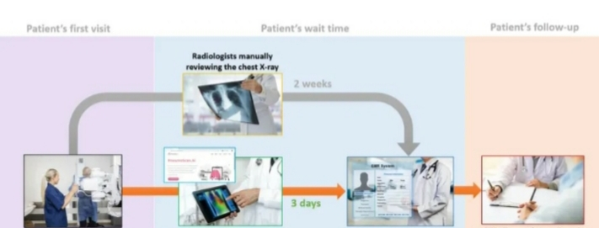

Slide 6
Scope for application
Current model
Ultimately , what do we gain?
* Decreased corruption In the healthcare system
*equal treatment given to one and all as the whole process has been digitalized.
*immediate action can be taken as and when required .
*Therefore , death rate sees a significant decrease
Personalized booking for covid – 19 testing
Using the obtained test results and x ray from the existing module
Extension of application to enable , viewing availability and booking of bedsat hospitals

Slide 7
About the pneumonia predicting model
We use an image classifier that works on convolusional neural networks in Keras .
We send in two classes of training images for the pneumonic condition and for the non – pneumonic condition .
We are technically performing a binary classification as there only 2 classes and we expect to get an output of 1 for pneumonia positive and 0 for pneumonia negative .

Slide 8
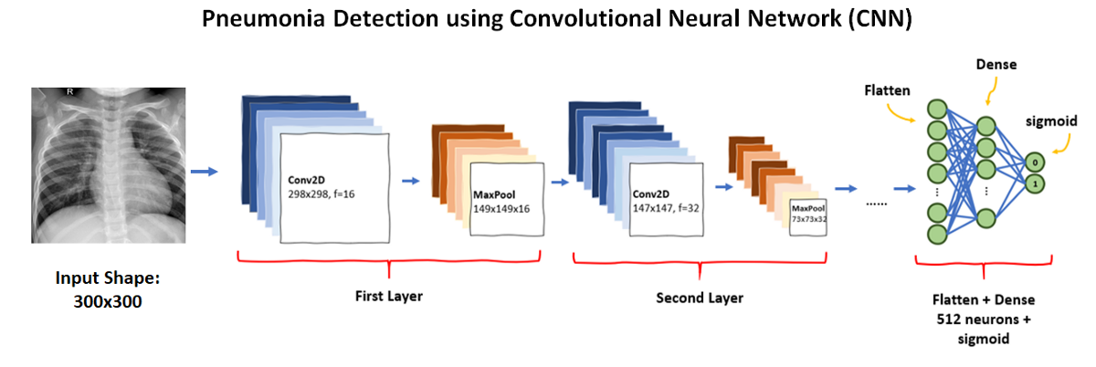

Slide 9
Where can it be used?
Corporate companies
hospitals
Government offices
Schools & colleges
factories
malls
The parliament
Other public places like post offices

Slide 10
pros
Its an alternative method to test for the possibility of C0vid – 19 .
Though , it does not deliver the most accurate results , it makes it easier to test for a large number and its also cheaper and more available than the original testing kits .
It can be placed in various environments for multiple purposes . E.g.- hospitals, corporate companies
It reduces risk of spread of disease in the community due to its faster processing and also since it gives an earlier insight about the condition of the patient , death rate is reduced .
Further more, the process is entirely digitalized limiting any sort of interaction or contact with people at least for the initial phase .

Slide 11
cons
It is just more of a recommendation system rather than a prediction system .
It might not give the most accurate results.

Slide 12
Thank You !
Have A Great Day : )

